Slide 1
Linear Algebra
Lecture 21

Slide 2
Vector Spaces

Slide 3
Null Spaces,
Column Spaces, and
Linear Transformations

Slide 4
Subspaces arise in
as set of all solutions to a system of homogenous linear equations as the set of all linear combinations of certain specified vectors

Slide 5
Definition
The null space of an m x n matrix A (Nul A) is the set of all solutions of the hom equation Ax = 0
Nul A = {x: x is in R^{n} and Ax = 0}

Slide 6
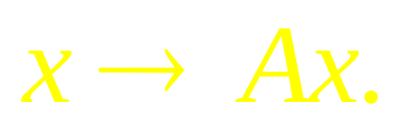
A more dynamic description of Nul A is the set of all x in R^{n} that are mapped into the zero vector of R^{m} via the linear transformation
Nul A
0
R^{m}
R^{n}

Slide 7
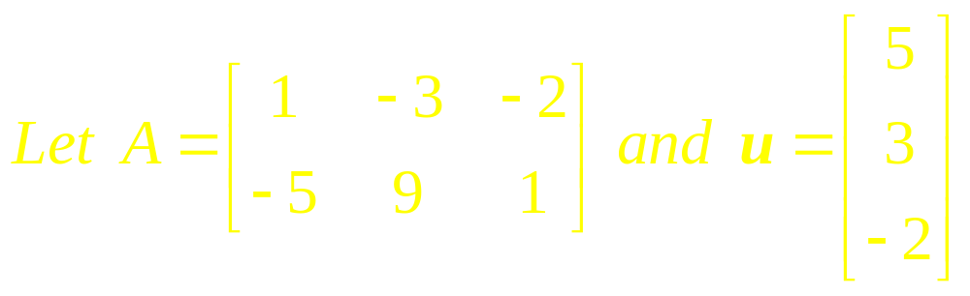
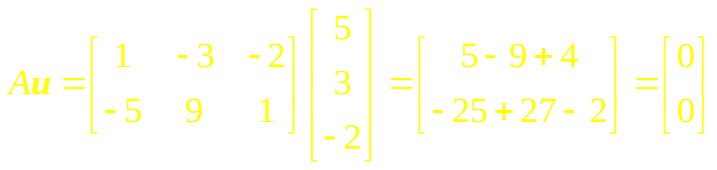
Example 1

Slide 8
Theorem
Elementary row operation does not change the null space of a matrix.

Slide 9
Theorem
The null space of an m x n matrix A is a subspace of R^{n}. Equivalently, the solution set of m hom. linear equations in n unknowns (AX=0) is a subspace of R^{n}.

Slide 10
Example 2
The set H, of all vectors in R⁴ whose coordinates a, b, c, d satisfy the equations
a – 2b + 5c = d
c – a = b
is a subspace of R⁴.

Slide 11
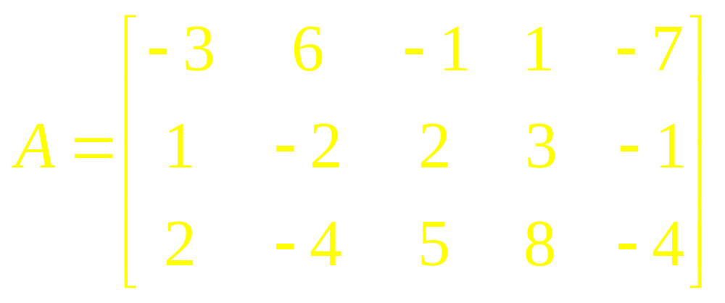
Example 3
Find a spanning set for the null space of the matrix

Slide 12
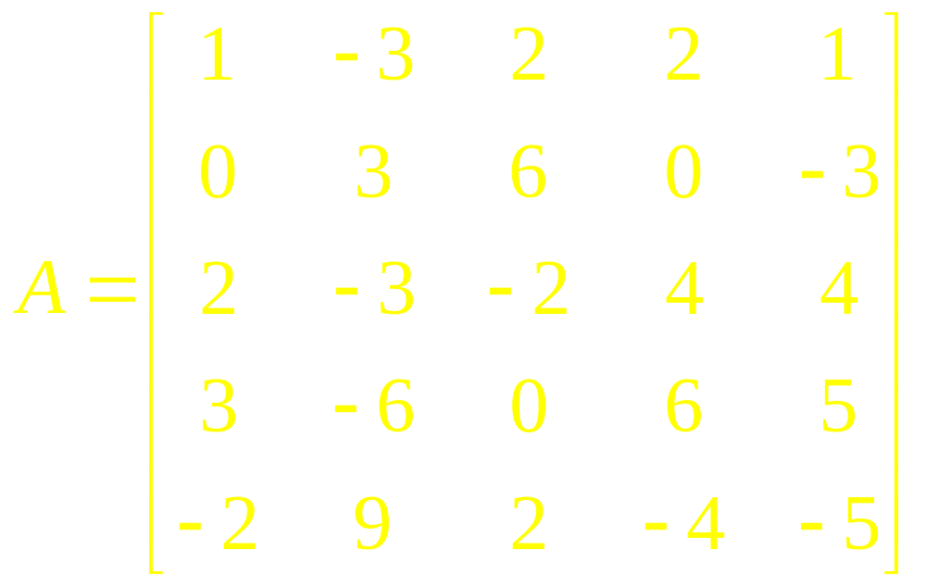
Example 4
Find a spanning set for the null space of

Slide 13
Definition
The column space of an m x n matrix A (Col A) is the set of all linear combinations of the columns of A.

Slide 14
continued
If A = [a₁ … a_{n}],
then
Col A = Span {a₁ ,… , a_{n} }

Slide 15
Theorem
The column space of a matrix A is a subspace of R^{m}.

Slide 16
Note
A typical vector in Col A can be written as Ax for some x because the notation Ax stands for a linear combination of the columns of A. That is,

Slide 17

continued
Col A = {b: b = Ax for some x in R^{n}}
The notation Ax for vectors in Col A also shows that Col A is the range of the linear transformation

Slide 18
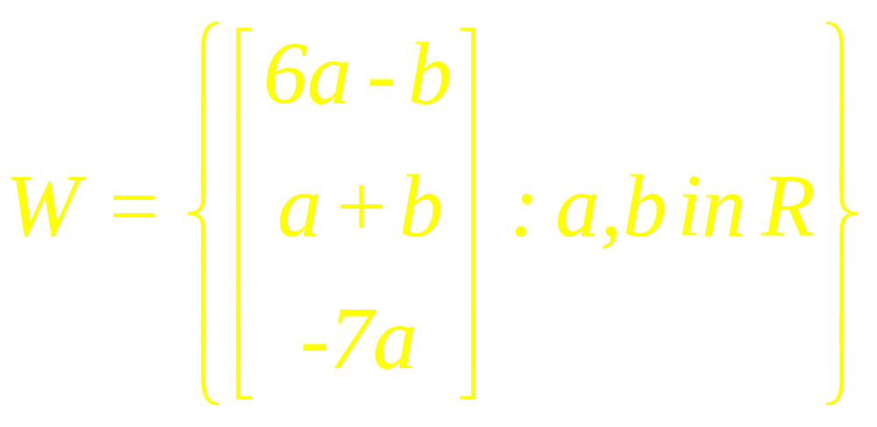
Example 5
Find a matrix A such that W = Col A.

Slide 19
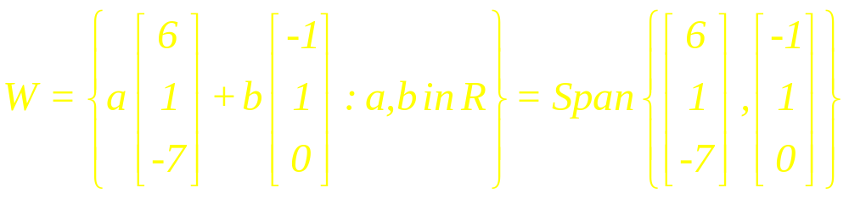
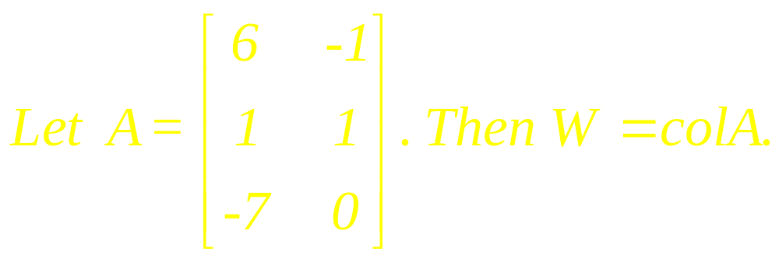
Solution

Slide 20
Theorem
A system of linear equations Ax = b is consistent if and only if b is in the column space of A.

Slide 21
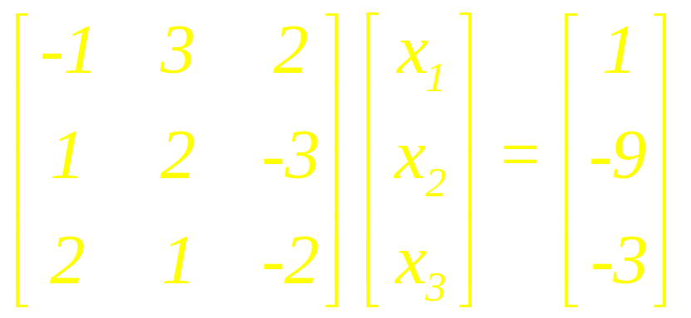
Example 6
A vector b in the column space of A. Let Ax = b is the linear system

Slide 22
continued
Show that b is in the column space of A, and express b as a linear combination of the column vectors of A.

Slide 23
Theorem
If x₀ denotes any single solution of a consistent linear system Ax =b and if v₁, …, v_{k} form the solution space of the homogeneous system Ax = 0,

Slide 24
continued
then every solution of Ax = b can be expressed in the form
x = x₀ + c₁v₁ + … + c_{n}v_{n}

Slide 25
Definition
The vector x₀ is called a Particular Solution of Ax = b.

Slide 26
continued
The expression
x₀+ c₁ v₁+ c₂v₂+ . . . +c_{k} v_{k} is called the
General Solution of
Ax = b

Slide 27
continued
The expression
c₁ v₁+ c₂v₂+ . . . +c_{k} v_{k}
is called the
General Solution
of Ax = 0.

Slide 28
Example 7
Find the vector form of the general solution of the given linear system Ax = b; then use that result to find the vector form of the general solution of Ax=0.

Slide 29
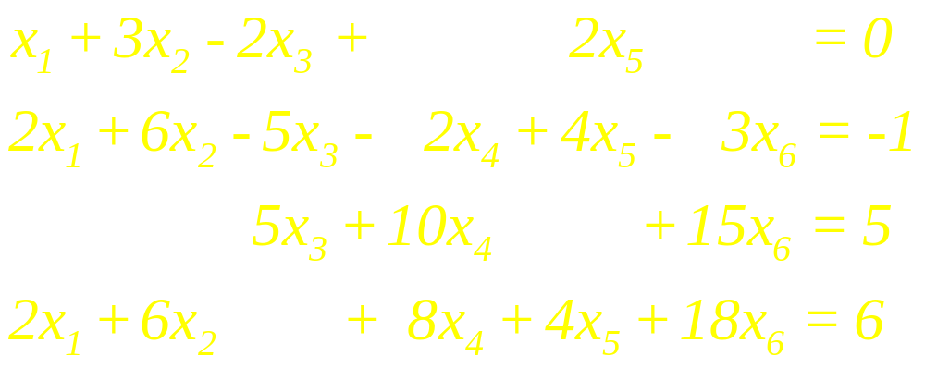
continued

Slide 30
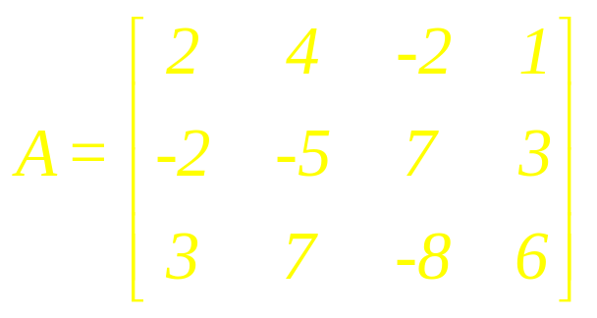
Example 8
a. If the column space of A is a subspace of R^{k}, what is k?
b. If the null space of A is a subspace of R^{k}, what is k?

Slide 31
Solution
a. The columns of A each have three entries, so Col A is a subspace of R^{k}, where k = 3.

Slide 32
continued
b. A vector x such that Ax is defined must have four entries, so Nul A is a subspace of R^{k}, where k = 4.

Slide 33
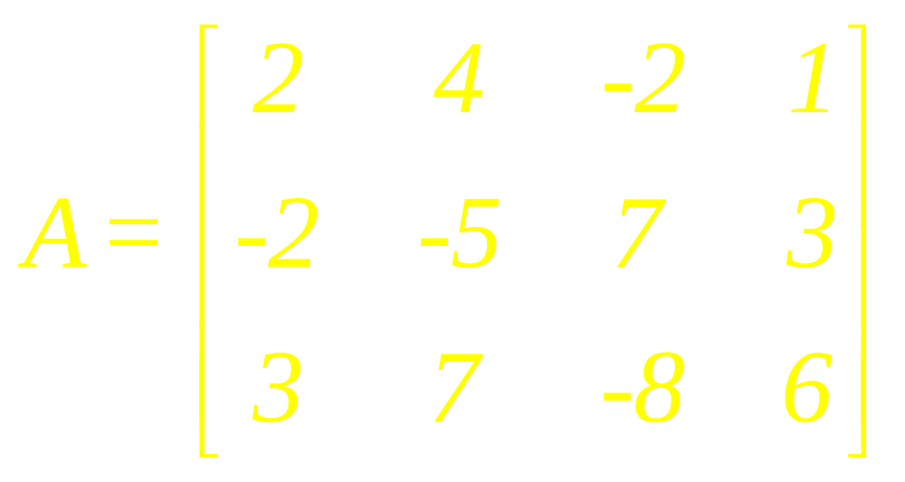
Example 9
Find a nonzero vector in Col A and a nonzero vector in Nul A.

Slide 34
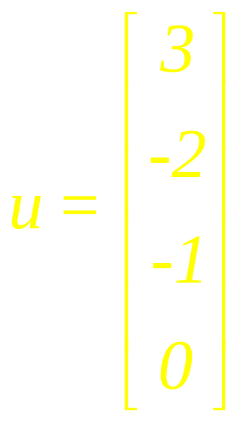
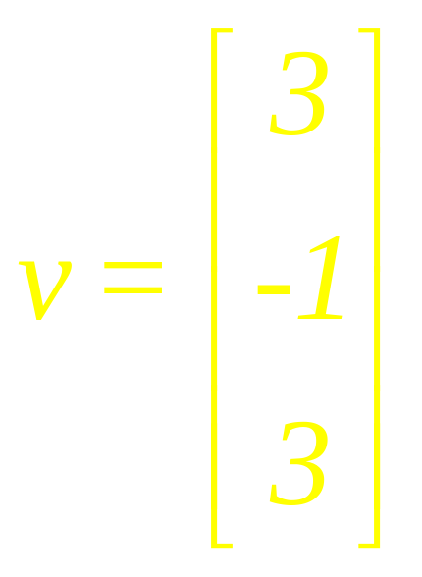
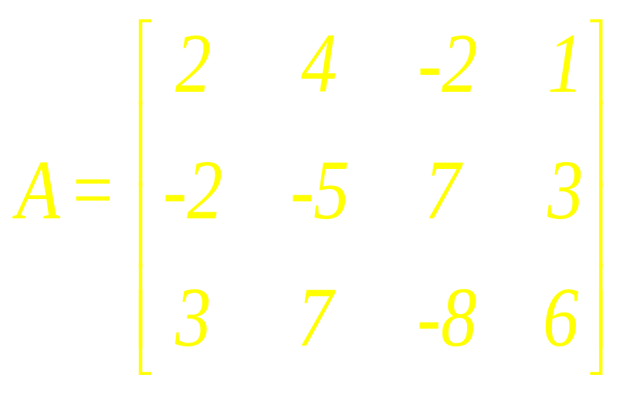
Example 10

Slide 35
continued
a. Determine if u is in Nul A. Could u be in Col A?
b. Determine if v is in Col A. Could v be in Nul A?

Slide 36
Summary

Slide 37
Definition
A linear transformation T from V into W is a rule that assigns to each vector x in V a unique vector T (x) in W, such that

Slide 38
continued
(i) T (u + v) = T (u) + T (v) for all u, v in V, and
(ii) T (cu) = c T (u) for all u in V and all scalars c

Slide 39
Definition
The kernel (or null space) of such a T is the set of all u in V such that T (u) = 0.

Slide 40
Definition
The range of T is the set of all vectors in W of the form T (x) for some x in V.

Slide 41
If T (x) = Ax for some matrix A – then the kernel and the range of T are just the null space and the column space of A.

Slide 42
Remarks
The kernel of T is a subspace of V and the range of T is a subspace of W.
Domain
Range
0
0
W
V’
Kernel
Kernel is a subspace of V
Range is a subspace of W

Slide 43
Examples

Slide 44
Linear Algebra
Lecture 21

